Slide 1
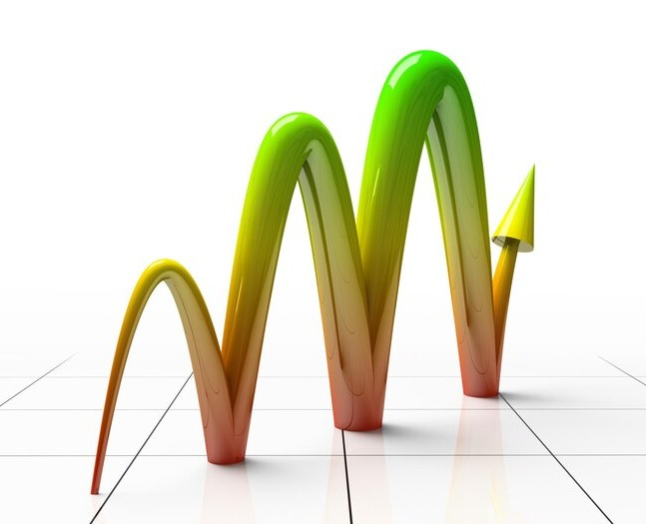
UNDERSTANDING NORMAL AND LOG NORMAL DISTRIBUTIONS: KEY CONCEPTS AND APPLICATIONS

Slide 2

INTRODUCTION
An overview of Normal and Log Normal distributions, their characteristics, and signiﬁcance in statistics and data analysis.
Understanding these distributions is crucial for various applications in science and engineering.

Slide 3

NORMAL DISTRIBUTION
The Normal distribution, also known as the Gaussian distribution, is characterized by its symmetric bell curve. It is widely used to model natural phenomena such as heights, weights, and test scores. Its parameters are the mean and standard deviation.

Slide 4
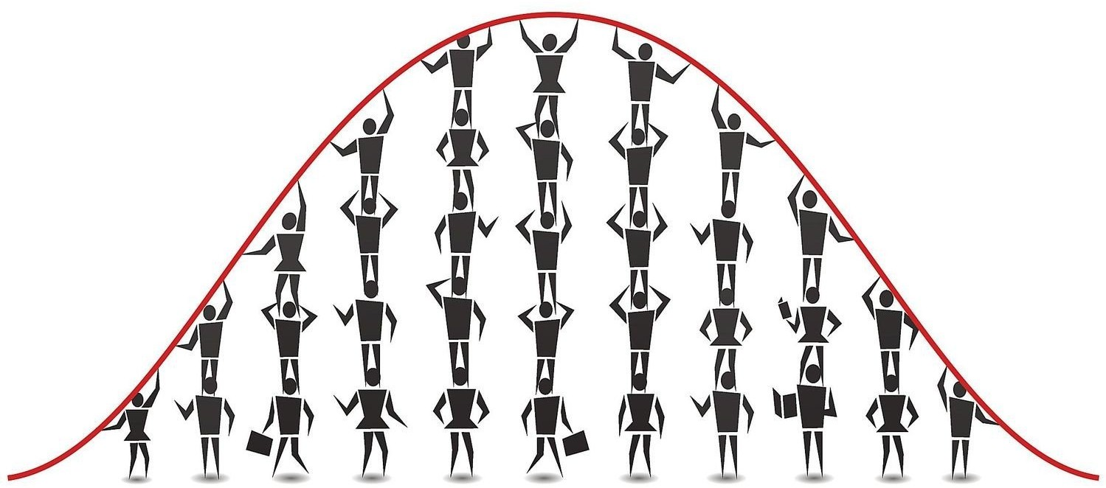
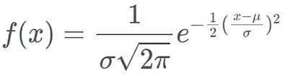

Slide 5

PROPERTIES OF NORMAL DISTRIBUTION
The key properties of the Normal distribution include its symmetry around the mean, the empirical rule which states that approximately 68% of the data falls within one standard deviation of the mean, and the central limit theorem.

Slide 6

LOG NORMAL DISTRIBUTION
The Log Normal distribution describes positive-valued variables whose logarithms follow a normal distribution. It is commonly used to model phenomena such as income, stock prices, and city sizes.

Slide 7
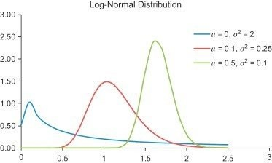

Slide 8

The Log Normal distribution is characterized by its skewed shape, with a long right tail. It is described by the parameters of the underlying normal distribution, the mean and standard deviation.
CHARACTERISTICS OF LOG NORMAL DISTRIBUTION

Slide 9

APPLICATIONS IN FINANCE
The Log Normal distribution is widely used in ﬁnance to model the distribution of stock prices, asset returns, and income levels. Understanding its properties is essential for risk management and portfolio optimization.

Slide 10

APPLICATIONS IN BIOLOGY
In biology, the Normal distribution is used to model traits such as height and weight, while the Log Normal distribution is employed to describe the distribution of biological variables like body size and metabolic rates.

Slide 11

STATISTICAL INFERENCE
Both the Normal and Log Normal distributions play a crucial role in statistical inference, hypothesis testing, and conﬁdence interval estimation. Understanding their properties is essential for drawing valid conclusions from data.

Slide 12

DATA ANALYSIS
The understanding of Normal and Log Normal distributions is fundamental for data analysis, including descriptive statistics, regression analysis, and predictive modeling. They provide valuable insights into the underlying patterns of the data.

Slide 13

CHALLENGES AND LIMITATIONS
While Normal and Log Normal distributions are widely used, it is important to be cautious when applying them, particularly in cases with extreme outliers or non-normal data. Understanding their limitations is essential for accurate analysis.

Slide 14
CONCLUSION
A summary of the key concepts and applications of Normal and Log Normal distributions, emphasizing their signiﬁcance in statistics, data analysis, and various ﬁelds of science and engineering.

